Slide 1
O.Peller & R.Malykin
The OR project

Slide 2
The problem:
We find the current public transport system very inefficient , and we want to evolve public transport to the next step, in which the bus lines are no longer constant, the costumer inputs the destination , and our bus system will match a vehicle to drop-off the costumer at the destination.
TECHNICAL PROBLEMS : matching n costumers into m vehicles with minimized waiting times , and efficient paths is indeed NP-Hard problem.

Slide 3


Scope & Goals:
Measure success : To measure our success we will compete with the papers we were inspired by and run our system on the same data,
and compare the results.
No AI : The state-of-the-art system suggests a major improvement by using AI to predict busy areas in the city , and send Idle vehicles there , this system is not included into our project. And is replaced by a statistical data analysis.

Slide 4
Tools and libs
The project is written in Python 3.
PyCharm & Jupyter .
Maps and geospatial data from open OpenStreetMap.
Graph infrastructure by NetworkX library.

Slide 5
To cut computing Time significantly all the papers suggested to create a map of all shortest paths , and all of their costs.
Our Manhattan NYC graph map hold more then 6000 nodes , and we found our limited computer memory had a problem holding.
Our approach was to create the shortest paths , and their costs in run time instead. Creating a dedicated “SPC-Dict” to start as an empty map , when our system needs the data , we check if the system already calculated the needed shortest path. And fetch it to the system , else it will calculate it and update it in our maps.
- This approach was fast and space conservative.
Preprocess

Slide 6
New York city government Data base , specifically 5-12.5.2013
https://www1.nyc.gov/site/tlc/about/tlc-trip-record-data.page
Cleaning the data 1: initially the data is cleaned from all the unused columns such as the amount of tip to the driver , and tax% from the cap fair, and so on…
Data
Adding data : we transformed to coordinate data to a usable nodes on the map of Manhattan . Giving each request Src and Dest.
An easy to use python notebook is provided to make theese steps!
Cleaning the data 11 : Corrupted data is also presented , abnormalities like trips with 0 passengers , src & dest that are outside of Manhattan and many more.
Cleaning the data 1 1 1 : While working in the project we found many new abnormalities in the data that happened mostly because of Manhattan NYC being and Island connected by bridges, this made us revisit the data preprocess many times along our development.

Slide 7
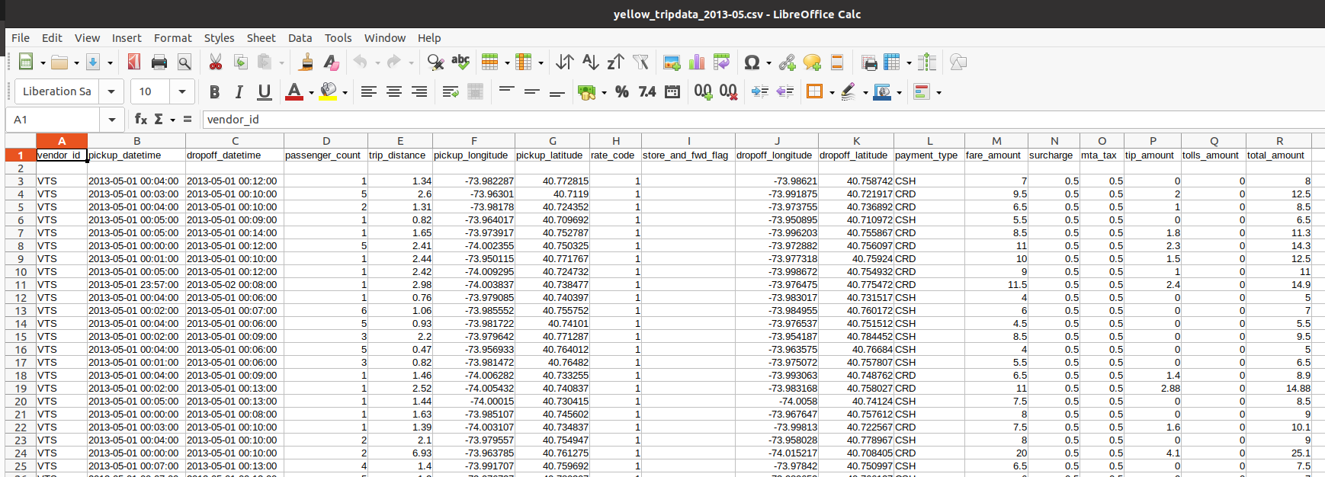
Original Data

Slide 8
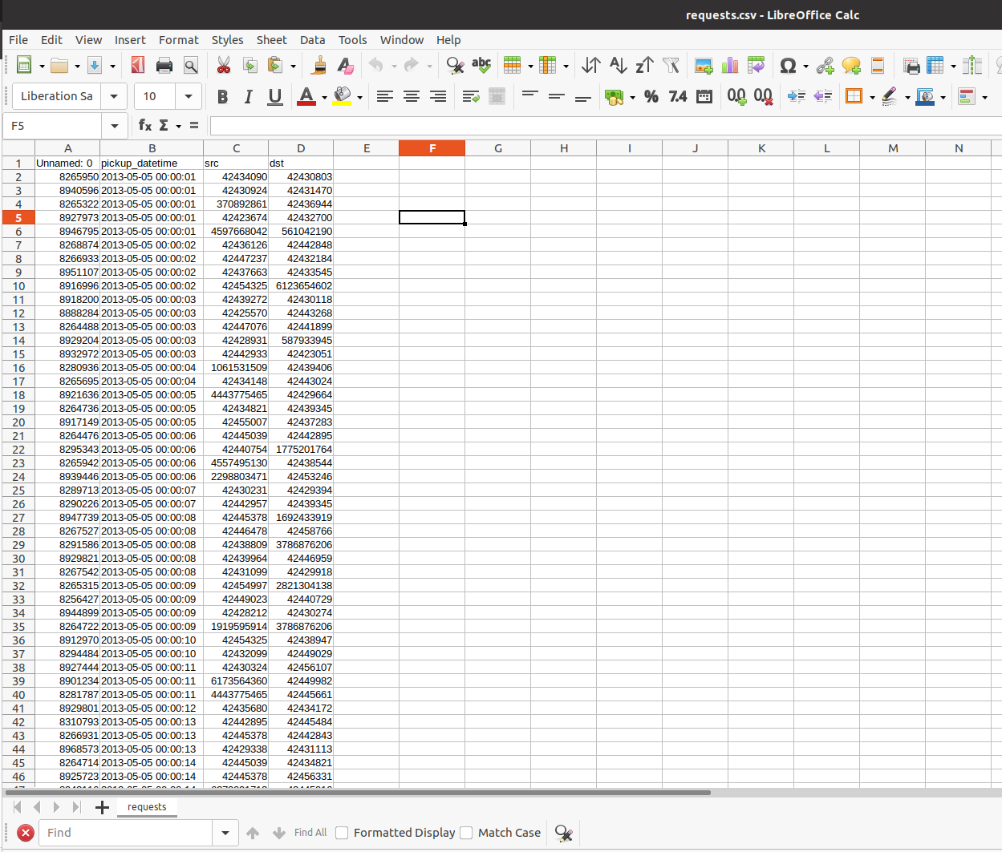
Final data

Slide 9
implementation
Classes & infrastructure
Algorithms

Slide 10
Classes & Infrastructure
We built a full framework to bring this project to life , using Object Oriented Programming paradigm.
Data Object classes to represent the real world ,objects Vehicles , Trips , Requests
Those object mostly hold the data , and updated data through out the systems workflow.
The objects design was initially based on the papers ideas but we adapted their design and attributes to fit OOP paradigm , and to isolate their functionality.
System helpers are classes who are responsible for the system running properly , they handle and parse data from the different objects , operating a log , and collecting statistics.
Runnin_Sim, Sim_init, Roies Utills, Spc_dict_caregiver.

Slide 11
Algorithems
Algorithm classes : RV_Graph ,RTV_Graph , TripAlgo , travel_node, Greedy_assingment.
Algorithm classes are divided into two categories.
To follow the paper, some of the classes are reconstruction of what the papers suggested.
The others were needed to be fully designed from scratch , as the papers were all using them but no actual algorithm was provided.

Slide 12

So what the system actually does? - Input
Input parameters:
1) Set of requests in csv format.
2) Number of vehicles.
3) Epoch length in seconds.
4) Time boundaries in which requests are going to be considered
(defined by startring time and the number of epochs)

Slide 13
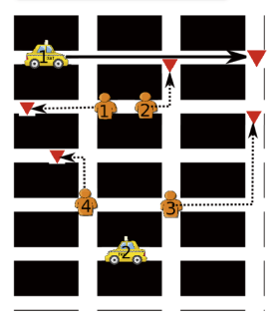
So what the system actually does? - Init the system
After the input is set , We create the fleet of vehicles , in strategical places where there should be a high demand , we took demand statistics from the analysis made in O’connors paper.
Input requests are separated into epochs , and each epoch will consist of new requests and the requests that were not yet served from previous epoch, but still can be served.

Slide 14
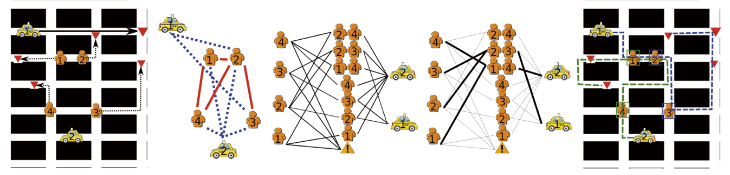
So what the system actually does?-For Each Epoch

Slide 15
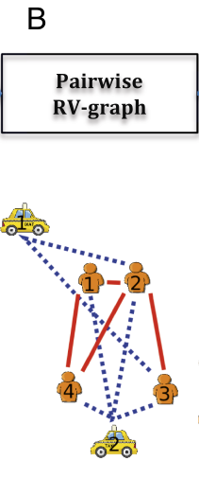
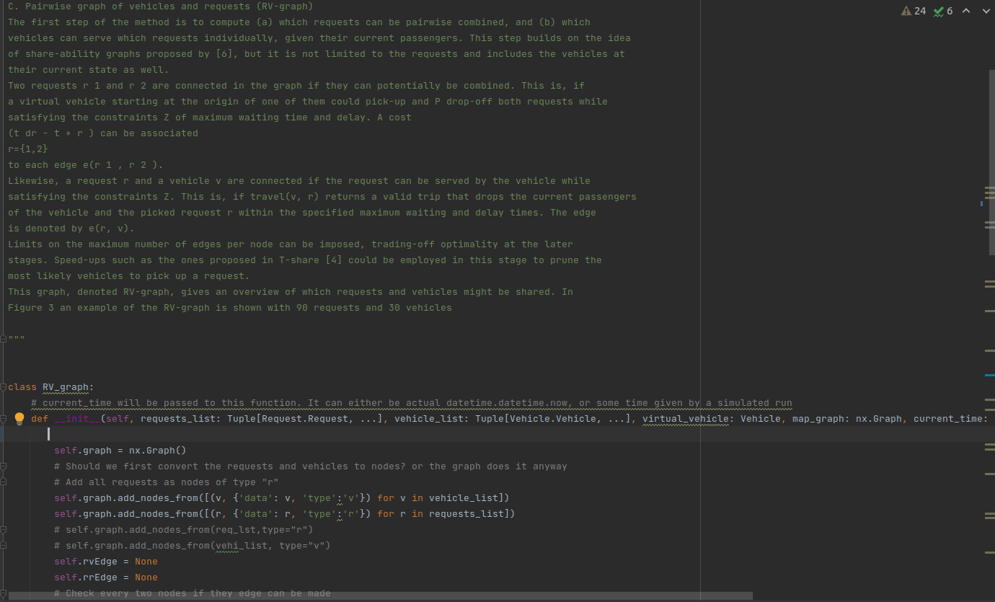
Pairwise Request and vehicles (RV_Graph)
With Travel request and Vehicle status as Graphs nodes , this Algorithm creates two special edges:
“Request-vehicle edge”: if the request can be served by this vehicle
“Request-Request” edge”: if two request can be served together”
TripAlgo algorithem considers all given constraints and allow edges to be made.

Slide 16
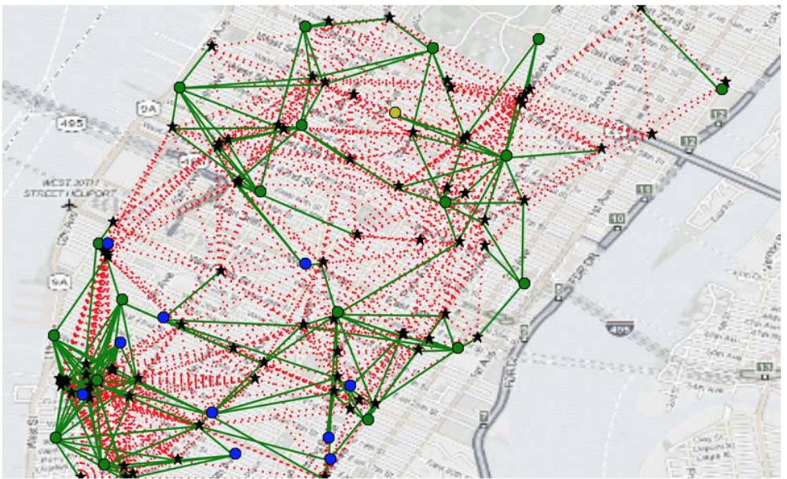
Pairwise Request and vehicles (RV_Graph)
With Travel request and Vehicle status as Graphs nodes , this Algorithm creates two special edges:
“Request-vehicle edge”: if the request can be served by this vehicle
“Request-Request” edge”: if two request can be served together”
TripAlgo algorithem considers all given constraints and allow edges to be made.

Slide 17
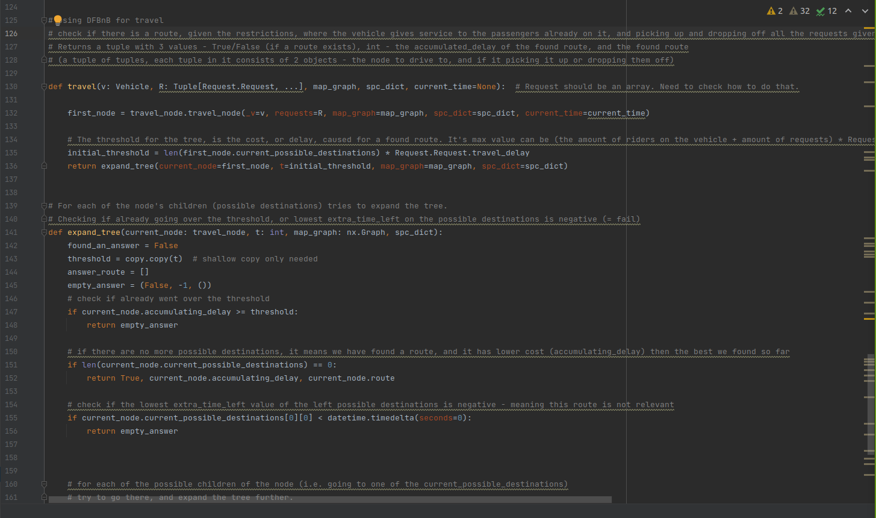
Trip algo and Trip node

Slide 18
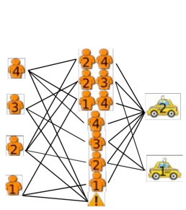
Requests-Trips-vehicles (RTV graph)
Receiving RV_Graph as input , This algorithm considers all request that can be combined into trips, and creates all the possible trips to be Nodes in the graph.
We consider every vehicle to serve every trip , if it is feasible ,an edge is created and holds the cost of this trip being served by the vehicles.

Slide 19
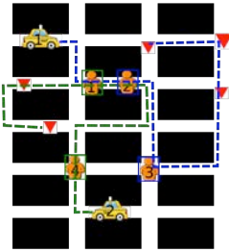
Greedy Assignment
This algorithem will greedly assign Trips to vehicles.
* A two dimentional sort is implemented on all the “TV-edges” from the RTV graph and stored in a stack , after the sort we consider the largest trips with the lowest cost first , after that smaller trips are considered.
All Unserved request that can be assinged in the next epoch ,will be appended to that epoch.

Slide 20
Important Notes of the implementation
1)TIME AND SPACE: As time & space are crucial part in this project , it is very important to us that the system will run as quickly as possible , so we can run and test it. Throughout the entire development the code was reviewed and re-edited to work faster , some functionalities running time was cut in half.
2) GOOD CODE :We had in mind that our system will be used and updated by others, so we wrote a good code , OOP paradigm designed , compact code with no duplications ,detailed documentation , git version control .

Slide 21
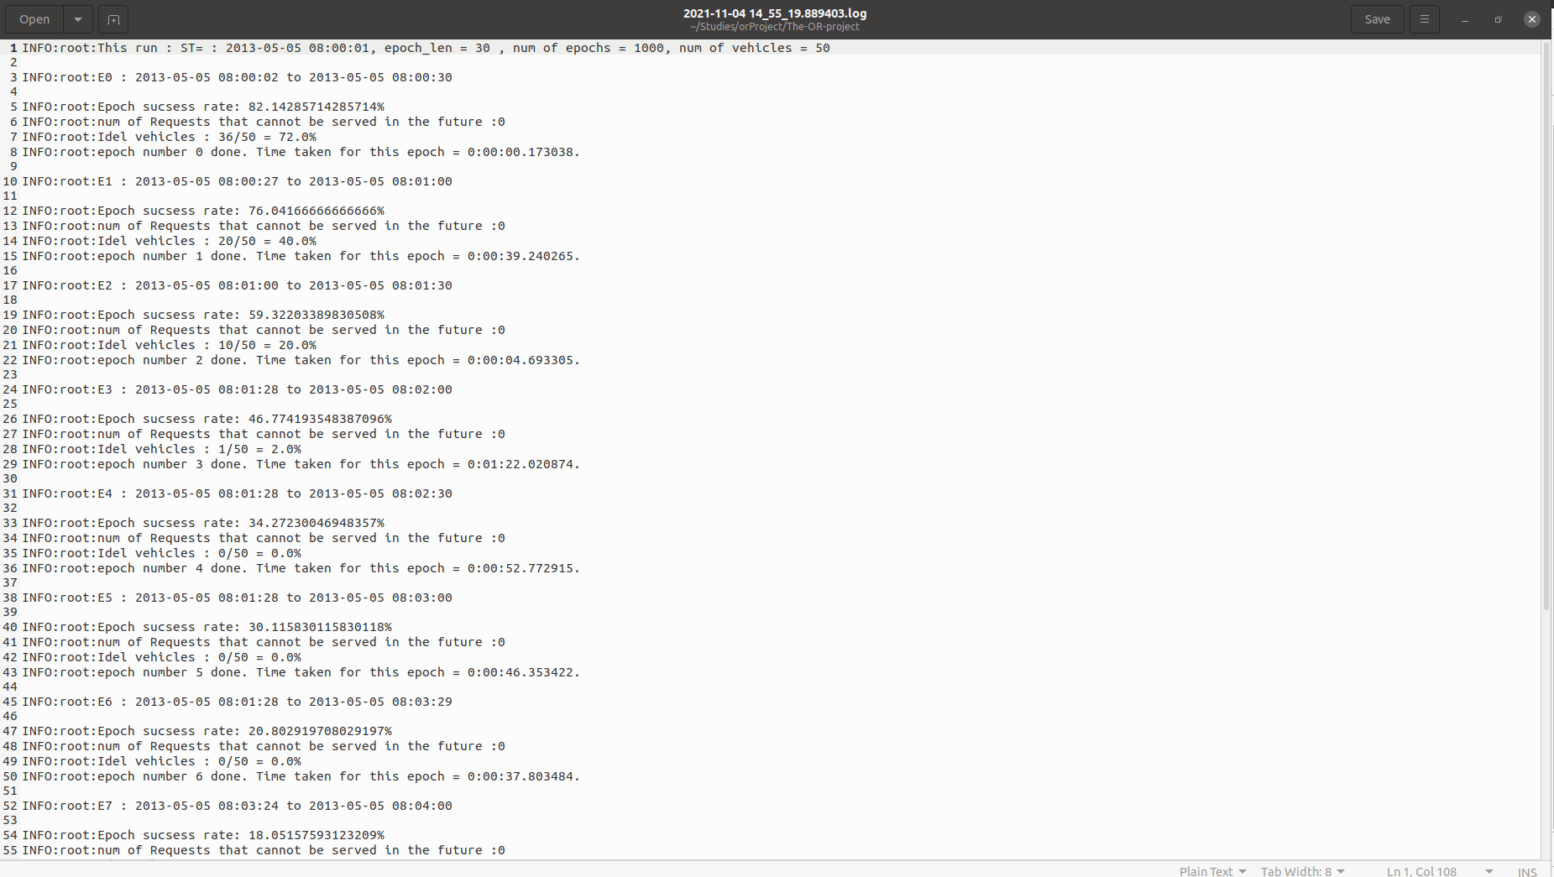
Results

